Slide 1

Resample-based Ensemble Framework for Drifting Imbalanced Data Streams
By: Jawdat haron

Slide 2
About the paper
This paper was done by HANG ZHANG1 , WEIKE LIU , SHUO WANG , JICHENG SHAN1 , QINGBAO LIU
Was published in 06 May 2019.
Made in China
IEEE paper.
Unfortunately there is no open source implementation for it online.

Slide 3
The aim of the paper
This paper was created to overcome the problem of classification of data streams that have minority classes and have data drifts (sudden or gradual).
It present a solution that overcome the minority class problem.
And overcome the drifting problem.

Slide 4
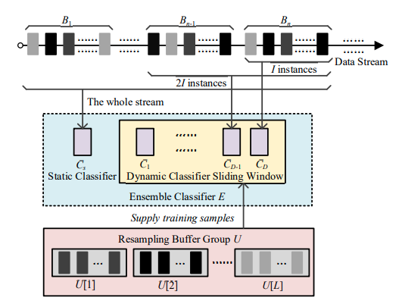
The solution

Slide 5
The Main algorithm
Inputs:
1. S: data stream
2. L: number of classes
3. I: size of the data blocks
4. D: number of dynamic classifiers
5. ɛ: instance selection ratio of the classifier initialization.
Output: Ensemble Classifier E

Slide 6
THE MAIN ALGORITHM
Initialization:
1. B: circular cache array, initialized as an empty array
2. U[l]: resampling buffer for storing instances
3. p=0: counter of processed instances
4. i=0: indicator of current position in circular cache array
5. k=0: indicator of the dynamic classifier

Slide 7
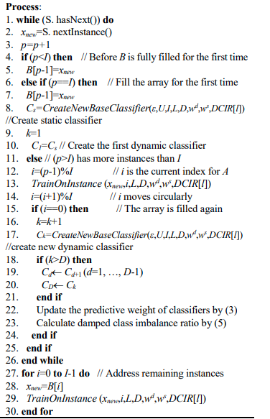
THE MAIN ALGORITHM

Slide 8
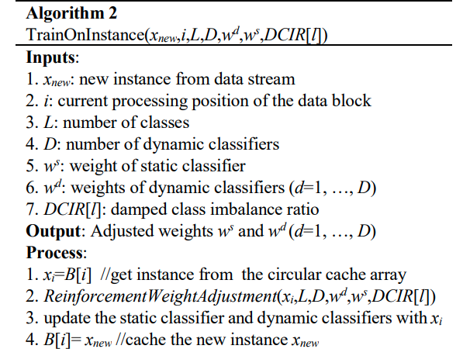
Train On Instance Algorithm

Slide 9
Reinforcement Weight Adjustment
Inputs:
1. x: processed instance of label y
2. L: number of classes
3. D: number of dynamic classifiers
4. w s : weight of static classifier
5. w d : weights of dynamic classifiers (d=1, …, D)
6. DCIR[l]: damped class imbalance ratio

Slide 10
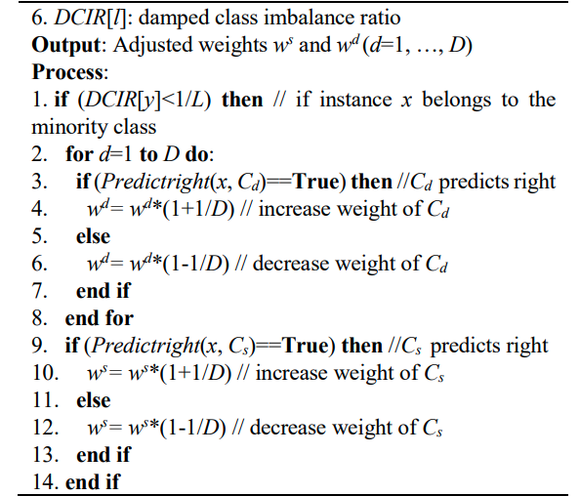
REINFORCEMENT WEIGHT ADJUSTMENT

Slide 11
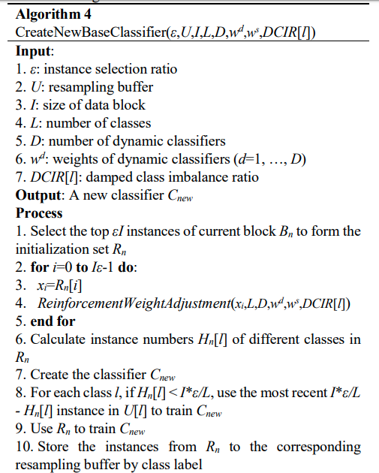
Create New Base Classifier

Slide 12
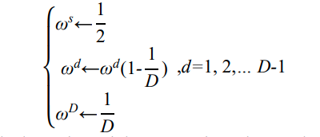
Update weights

Slide 13

DAMPED CLASS IMBALANCE RATIO

Slide 14

Prediction

Slide 15
Evaluation
For every test_point records has passed, we meaure the model on test_size next samples to check the accuracy.

Slide 16
experiments
As the paper used, we used the Hoffeding tree as a base classifier.
The data stream were used in the case of imbalanced data were there is sudden drifts and gradual drifts.
We used the scikit data stream generator to generate data streams.

Slide 17
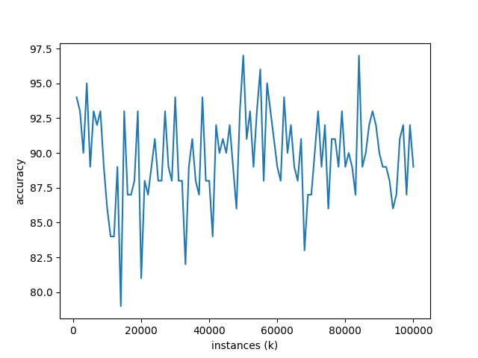
Results with gradual drift

Slide 18
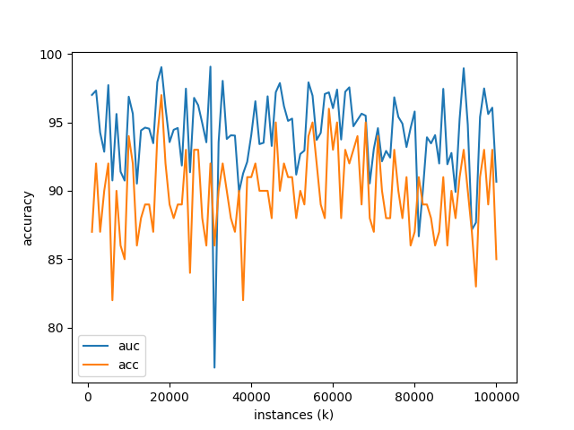
Results with gradual drift

Slide 19
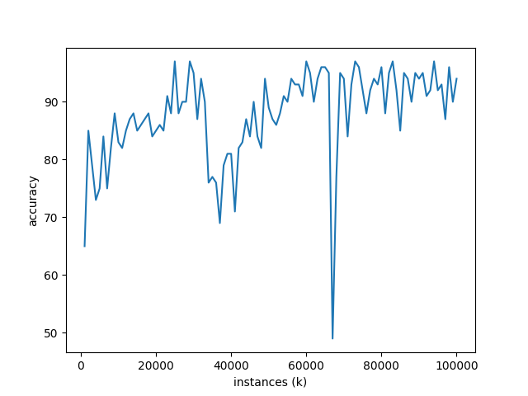
Results with sudden drift

Slide 20
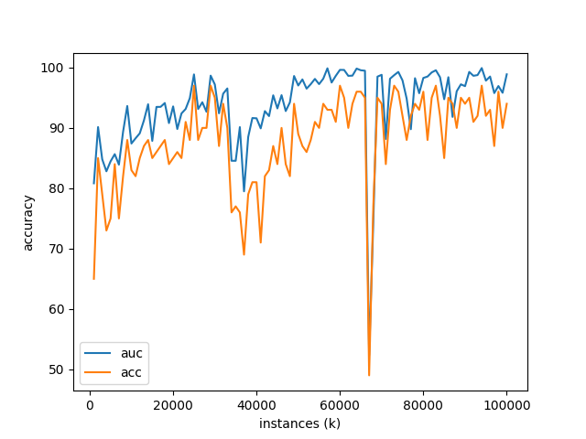
Results with sudden drift

Slide 21

Thank You
someone@example.com

